Slide 1
MGNM581 :: Unit – 3

Slide 2
Learning Outcomes
After attending this unit lectures the students will be able to
Form effective Groups and Teams
Decipher the causation of individual behaviour in the context of values, attitude and job satisfaction
Recognize various personality types
Apply Transactional Analysis to create an enabling team atmosphere

Slide 3
Learning Outcomes
Interpret human Perception with the anchoring of Attribution theory and take sound decisions
Demonstrate Emotional Intelligence with the anchoring of Affective Events Theory and create a positive team atmosphere

Slide 4
Group Dynamics and Team Development

Slide 5
Terminology
Group : Two or more individuals, interacting and inter-dependent, who have come together to achieve particular objectives.
Formal Group : A group defined by the organization, has a structure and designated work assignments
Informal Group : Its neither formally structured nor organizationally determined . It’s a natural formation in the work environment that appears as a result of the need for social interaction.

Slide 6
Discuss
Why do people form groups?

Slide 7
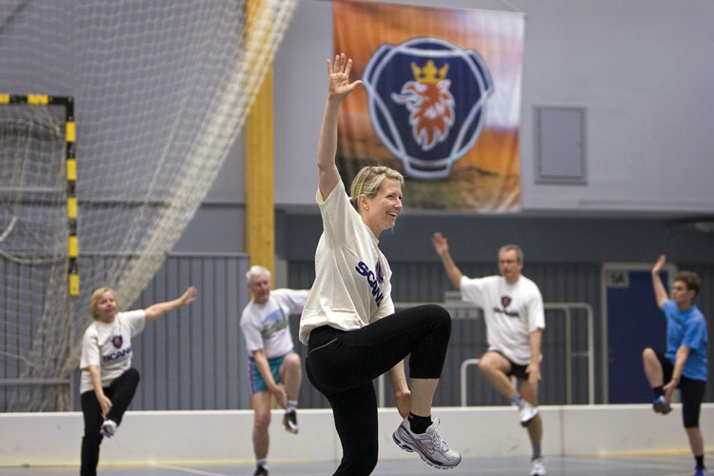


Slide 8
Scania
The employees of the Swedish transportation company Scania shown here exercising at a sports complex comprise an informal group.
At different company locations, Scania offers employees free access to sports facilities during working hours. The company puts a high priority on employee health and offers employees many opportunities to reinforce an active lifestyle.
The informal groups that participate in sports and exercise activities are neither formally structured nor organizationally determined. However, informal groups like these can fulfill employee desires for social interaction at work.

Slide 9
Group Dynamics
Group Dynamics refer to change which takes place within groups and is concerned with the interaction and forces operating between group members and social setting.

Slide 10
Types of Groups
Formal Group For official job relationship; to fulfil specific needs related to organizational mission | Informal Group Join together to satisfy social and psychological needs

Slide 11
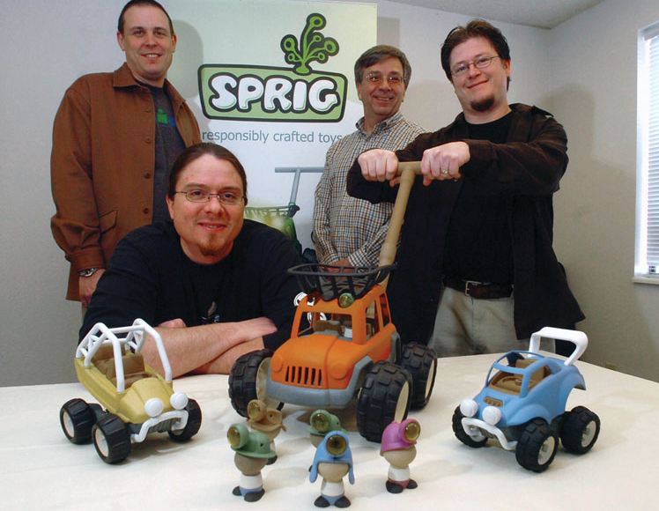

Slide 12
Sprig Toys
Sprig Toys, Inc. uses cross-functional teamwork in creating toys that are made of recycled products to keep the planet healthy and kids off the couch.
The Sprig Dream Team is a Cross-functional team includes toy designers and toy industry-specific expertise in the areas of product design, patent development, supply chain strategy, market research, vendor sourcing, merchandising, branding, packaging, and marketing.
Team members are dedicated to Sprig’s mission of creating fun toys that encourage active play for kids and are batteryfree, eco-friendly, and paint-free.

Slide 13
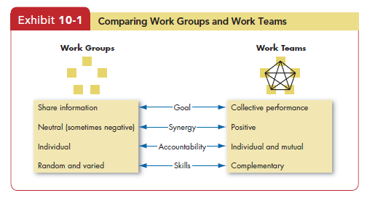
Group Vs. Team

Slide 14
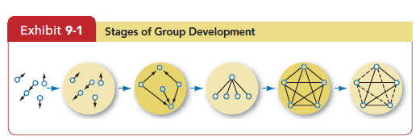
Stages of Group Formation
1. Forming
2. Storming
3. Norming
4. Performing
5. Adjourning

Slide 15
Activity- Overview of How Groups Develop
Forming: “We are all on our best behavior!”
Storming - “We all have different ideas on what should happen”
Norming - “We work out how to work together”
Performing - “We are effective and get things done easily!”
Adjourning - “We are happy or sad to be finishing”
Answer the questions below:
What’s going well in this stage for your group?
What is challenging?

Slide 16
VALUES

Slide 17
Values
Basic convictions about what is right, good or desirable
Honesty
Responsibility
Capability
Ambition
Independence
Self Respect
Family Security
Freedom
Achievement
Happiness

Slide 18
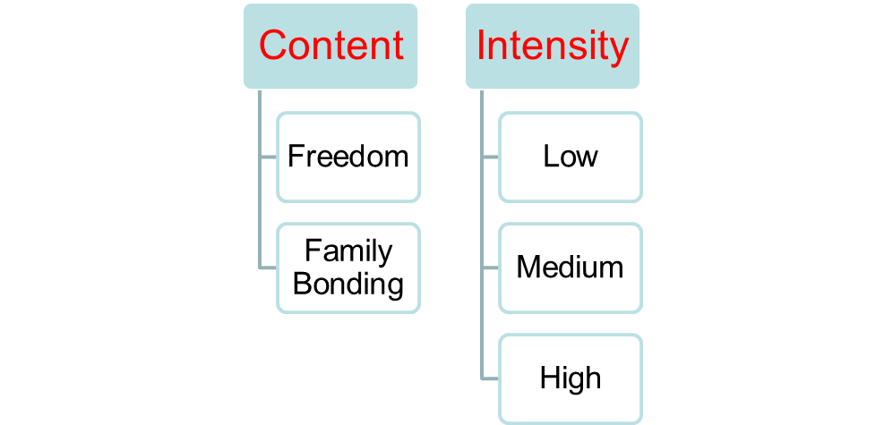
Values
2 Attributes of Values

Slide 19
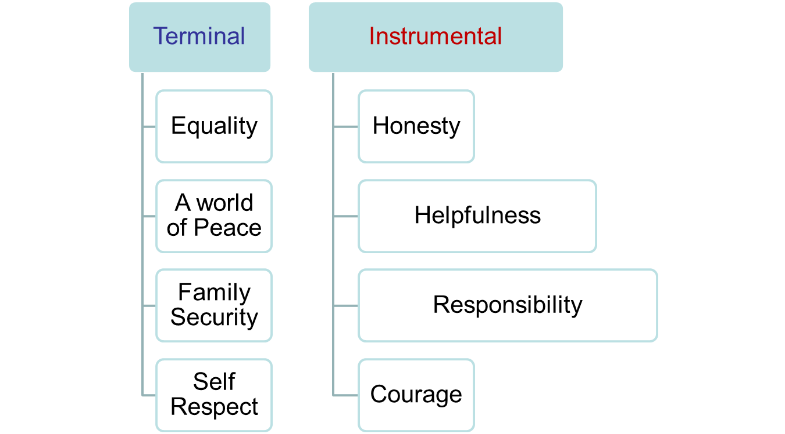
Types of values

Slide 20
Attitude
Evaluative statements – either favorable or unfavorable about objects, people, and events.

Slide 21
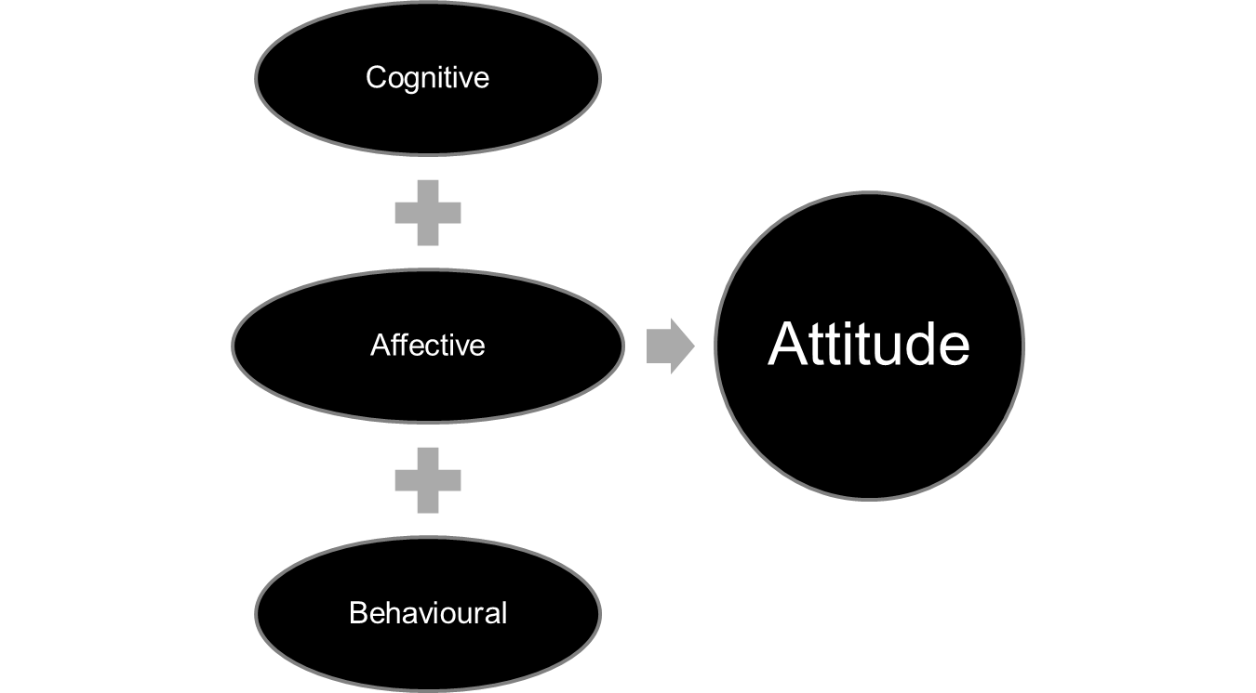
Components of Attitude

Slide 22
Examples
My house is too shabby! (cognitive / thought)
I am ashamed of the house I live in ! (affective / feeling)
I am going to move to a new house! (behaviour / action)

Slide 23
Time to ponder
State your attitude about “Mc.Donalds as a workplace”. Identify the 3 components of your attitude.

Slide 24
Case : SEVA CAFE
https://www.youtube.com/watch?v=9VFear0bn3k
Identify the VALUES, ATTITUDE and BEHAVIOUR that reflect job satisfaction of people working in SEVA CAFE

Slide 25
Personality
  How do you define Personality?

Slide 26
Personality
The sum total of the ways an individual reacts to and interacts with others
Enduring characteristics that describe an individual’s behaviour
Personality is described in terms of personality traits

Slide 27
The Big Five Traits
Extraversion : Sociable
Agreeableness : cooperative
Conscientiousness : Honesty
Emotional Stability : Calm , secure, self confident
Openness to Experience : creative, curious

Slide 28
What determines individual’s personality?
Heredity : Influence of genes
  Physical features
  Temperament
  Muscle composition
Socialization : Influence of
  Parents / Family
  Teachers
  Friends

Slide 29
Personality Tests
Myers – Briggs Type Indicator (MBTI)
  Extravert vs. Introvert
  Sensing vs. Intuititive
  Thinking vs. Feeling
  Judging vs. Perceiving
16 Personality Types
  INTJ
  ESFP

Slide 30
Q. 1 How do you get your Energy?
Extraverts = E
are generally sociable
are focused on the outer world
get energy by spending time with others
talk a lot & start conversations
speak first, then think
are quick to take action
have many friends & many interests
Introverts = I
are generally quiet
are focused on their inner world
get energy by spending time alone
mostly listen & wait for others to talk first
think first, then speak
are slow to take action
have a few deep friendships & refined interests

Slide 31
Q. 2 How do you see the world & gather information?
Sensors = S
have finely-tuned five senses
pay attention to the details
focus on what is real (in the present)
think in concrete terms
like practical things
like to do (make)
are accurate and observant
prefer to do things the established way
Intuitive = N
use their “sixth sense”
see the “big picture”
focus on what is possible (in the future)
think in abstract terms
like theories
like to dream (design)
are creative and imaginative
prefer to try out new ideas

Slide 32
Q. 3 How do you decide?
Thinkers = T
mostly use their head
make decisions based on logic
are more interested in things & ideas
treat everybody the same
(emphasizing fairness)
are more scientific in describing the world
Feelers = F
mostly use their heart
make decisions based on their values
are more interested in people & emotions
treat people according to their situation (emphasizing compassion)
are more poetic in describing the world

Slide 33
Q. 4 How much do you like to plan ahead?
Judgers = J
are organized and structured
make plans in advance
keep to the plan
like to be in control of their life
want to finalize decisions
Perceivers = P
are casual and relaxed
prefer to “go with the flow”
are able to change and adapt quickly
like to simply let life happen
want to find more information

Slide 34

Can you identify this Entrepreneur?

Slide 35
Falguni Nayar : CEO of Nykaa
A dreamer is always termed crazy, until the time he or she turns it into a reality.
Falguni Nayar, the founder of Nykaa, one of India’s biggest online fashion and lifestyle portal, had been living the ideal life.
She served Kotak Mahindra for approx. 18 years as a venture investor and left in 2012 as Managing Director
She suddenly announced her departure to pursue her dream.
Capitalizing on the scope of beauty products online, she steered herself towards Nykaa, and out came a platform that created history with its arrival.

Slide 36
Falguni Nayar : CEO of Nykaa
Running her online business successfully, along with 35 physical stores, make way for an entrepreneur who told the world that age is just a number.
The brand is now an epitome in wellness and beauty, and it is further opening its luxury stores (Nykaa luxury) in premier destinations.
Nykaa has also been a front runner in bringing international luxury brands to India, giving Indian customers all-encompassing products and services to choose from.

Slide 37
Based on this information , what do you infer about Falguni’s Personality?

Slide 38
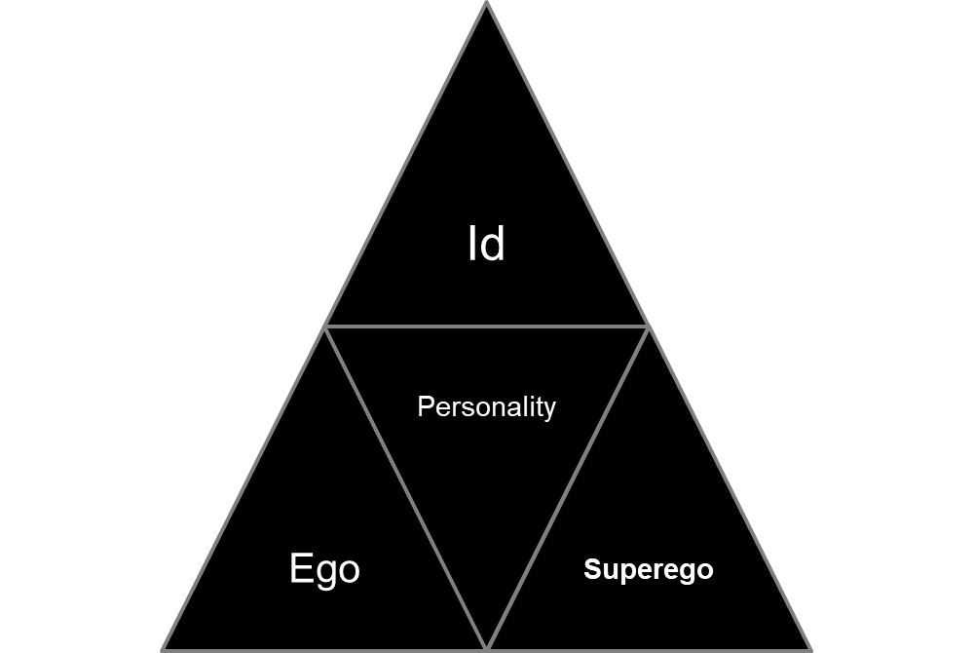
Sigmund Freud’s Theory of Personality
Sigmund Freud : early 20th century
3 components of Personality

Slide 39
Sigmund Freud’s Theory of Personality
Id
  Instant gratification of desires
  irrational and emotional part of the mind
Ego
  functions as the rational / logical part of the mind
  It balances the demands of Id and Superego
Superego
  moral part of the mind, a manifestation of societal or parental values.

Slide 40
Sigmund Freud’s Theory of Personality
Human personality is multi-faceted
Our thoughts, feelings, and behaviors are a result of the interaction / transaction between id, ego and superego

Slide 41
Transactional Analysis
Eric Berne
Transactional Analysis is the method for studying interactions between individuals.
3 ego states
  Parent
  Adult
  Child.

Slide 42
Parent Ego State
Parent – The parent represents a massive collection of recordings in the brain of external events experienced or perceived in approximately the first five years of life.
  “Never talk to strangers”
  “Always chew with your mouth closed”
  “Look both ways before you cross the street”

Slide 43
Child Ego State
Child – In contrast to the Parent, the Child represents the recordings in the brain of internal events associated with external events the child perceives.
the emotions or feelings which accompanied external events from childbirth all the way up to the age of approximately 5 years old.
Examples of recordings in the Child include:
“When I saw the monster’s face, I felt really scared”
“The clown at the birthday party was really funny!

Slide 44
Adult Ego State
Adult ego is “a data-processing computer, which grinds out decisions after computing the information from three sources: the Parent, the Child, and the data which the adult has gathered and is gathering”
“Wow! It really is true that we should observe people enough before we trust them with personal information” said Sally as she saw her friend loose reputation because of divulging personal information to colleagues.

Slide 45
Types of human transactions
Complementary transactions
Crossed Transactions
Ulterior Transactions
https://www.youtube.com/watch?v=7tpeKK0FxFU

Slide 46
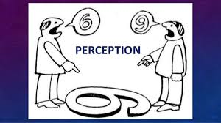

Slide 47
Learning Outcomes
  What is Perception?
  Factors influencing Human Perception
  Attribution Theory of Perception
  Perceptual Errors

Slide 48
Perception
The process by which individuals organize and interpret their sensory impressions in order to give a meaning to their environment.
Perception about :-
  Organizational Support
  Fairness of pay
  Working Conditions
  Job assignments – interesting or not
  Is my organization a Great Place to Work

Slide 49
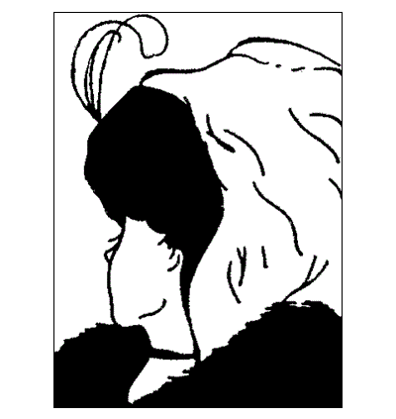

Slide 50


Slide 51
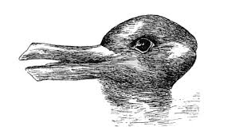

Slide 52
Attribution Theory
Given by Kelley
Specifically, “attribution theory concerns the process by which an individual interprets events as being caused by a particular part of a relatively stable environment.”
Observation……Interpretion…..Attribution of Cause
Externally Caused / Internally caused
  Distinctiveness
  Consensus
  Consistency

Slide 53
Attribution Theory
Example : Saujanya is late in reaching office
Distinctiveness : -
  Is this behaviour distinct or he also engages in other deviance behaviours e.g careless errors, workplace gossip, casual approach?
  High Distinctiveness – Behaviour is externally caused
Consensus :-
  Are other employees also late today? Traffic jam?
  High Consensus - Behaviour is externally caused
Consistency
  Is Saujanya usually late?
  Low Consistency – Behaviour is externally caused

Slide 54
Emotional Intelligence

Slide 55
Context
Have you ever thought of why people of average intelligence outperform people with the higher level of intelligence ?

Slide 56
Terminology
Affect is a generic term that covers a broad range of feelings people experience, including both emotions and moods.
Emotions are intense feelings directed at someone or something.
Moods are less intense feelings than emotions and often
(though not always) arise without a specific event acting as a stimulus.

Slide 57
Example
If someone is rude to you, you’ll feel angry. That intense feeling probably comes and goes fairly quickly, maybe even in a matter of seconds : Emotion
When you’re in a bad mood, though, you can feel bad for several hours.
When a colleague criticizes how you spoke to a client, you might show emotion (anger) toward a specific object (your colleague).
But as the specific emotion dissipates, you might just feel generally dispirited. You can’t attribute this feeling to any single event; you’re just not your normal self. You might then overreact to other events. This affect state describes a mood.

Slide 58
Affective events theory (AET)
Affective events theory (AET) demonstrates that employees react emotionally to things that happen to them at work, and this reaction influences their job performance and satisfaction.

Slide 59
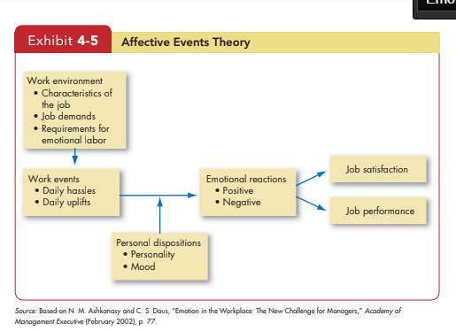

Slide 60
EQ Composition
 | What I See | What I Do
Personal Competence | Self-Awareness | Self- Management
Social Competence | Social Awareness | Relationship Management
Emotional Intelligence is made up of Four Core Skills

